Slide 1


Best Practices in Power BI

Slide 2
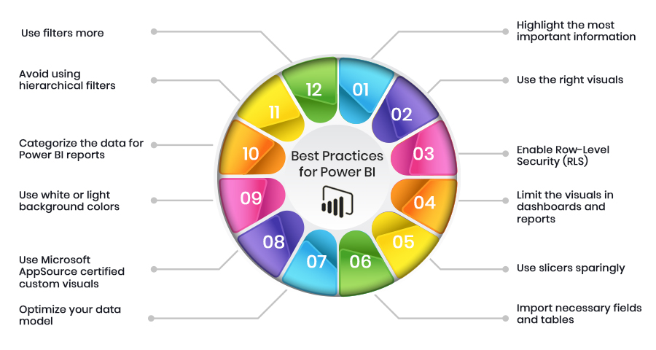

Slide 3
Limit the number of visuals in dashboards and reports
According to Microsoft's Optimization guide for Power BI, placing many visuals in a single report slows report performance.
Limit widget visuals to eight per report page and grids to one per page. Limit pages 30 points (cards: 1, gauges: 2, charts: 3, maps: 3, grids: 5).
Limit tiles to 10 per dashboard

Slide 4
To improve Power BI report performance, remove unnecessary interactions between visuals
By default, all visuals on a report page can interact with one another. For optimal report performance, interactivity should be minimized.
Reduce the number of queries fired at the back end and improve report performance by disabling unnecessary interactivity

Slide 5
Enable Row Level Security (RLS)
Row Level Security restricts user access to certain rows in a database depending on the characteristics (role) of the user executing a query. With RLS, Power BI only imports data the user is authorized to view.
Combining Power BI roles with roles in the back end can result in substantial performance gains.
Test all roles before rolling out to production.

Slide 6
Use Microsoft AppSource certified custom visuals
Power BI certified visuals are AppSource visuals that have passed rigorous quality testing. Microsoft verifies that certified custom visuals have robust, high-performance code.
Certified custom visuals are the only custom visuals that can be viewed in Export to Power point mode and email subscriptions.

Slide 7
Use preview feature of hierarchy slicers instead of custom visual
If you need to show hierarchy in slicers, enable the preview feature provided by the Power BI desktop instead of using of a custom visual.

Slide 8
Provide data categorization for Power BI reports (HBI, MBI, LBI)
High Business Impact (HBI) data requires users to get a policy exception to share the data externally. Low Business Impact (LBI) and Medium Business Impact (MBI) data do not require exceptions.
By using Power BI data sensitivity labels, you raise user awareness about required security and how reports should be shared inside and outside the organization.

Slide 9
Use On-premises data Gateways instead of Personal Gateway
Personal Gateway takes data and imports it into Power BI.
Enterprise Gateway (on-premises data gateway) imports nothing, which is more efficient when working with large databases.

Slide 10
Limit complicated complex measures and aggregations in data models
Push calculated columns and measures to the source where possible. The closer they are to the source, the higher the likelihood of improved performance.
Create calculated measures instead of calculated columns.
Use star schema to design data models.

Slide 11
Use Slicers Accordingly
Slicers are a great way of allowing users to navigate data, but they come at a performance cost. Each slicer generates two queries: one gets the data, and the other fetches selection details.
Creating too many slicers negatively impacts performance. To evaluate which slicers are infrequently used, use the Filter pane and remove unnecessary slicers.

Slide 12
Import only necessary fields and tables instead of entire datasets
Ensure the model is as narrow and lean as possible.
Power BI works on columnar indexes; longer and leaner tables are preferred.

Slide 13
Use white or light background colors
For users distributing printed reports, white or light backgrounds are printer friendly.

Slide 14
Use Report Tooltip pages to provide more context for the highlighted measure
Report tooltips are a great way of sharing additional information on the metric.
Use limited visuals in Report Tooltip.
Ensure you select Tooltip field carefully (categorical or measure).

Slide 15
Use names that are meaningful to your business users or intended audience
Power BI provides the ability to give aliases to report objects.
Avoid ambiguity when naming columns and measures.
Consider hiding unused columns in the data model.

Slide 16
Avoid scrolls within the visual and on page
Multiple scrolls on a single page lead to a negative user experience.
Limit your page size to the standard sizes as often as possible and use the Bookmark and Selection pane to toggle the visibility of visuals.

Slide 17
Use drill through buttons to generate an intuitive user experience
Enable drill through buttons; these are more intuitive than right click on data points.
Use conditional formatting to make the text on the button context-driven.

Slide 18
THANK YOU

